Slide 1



AutoRecords
Notes:
Welcome to this brief overview of the AutoRecords records management solution for M-Files. AutoRecords is available from the M-Files Solution Catalog and it is sold and supported by M-Files.
Importantly, AutoRecords

Slide 2
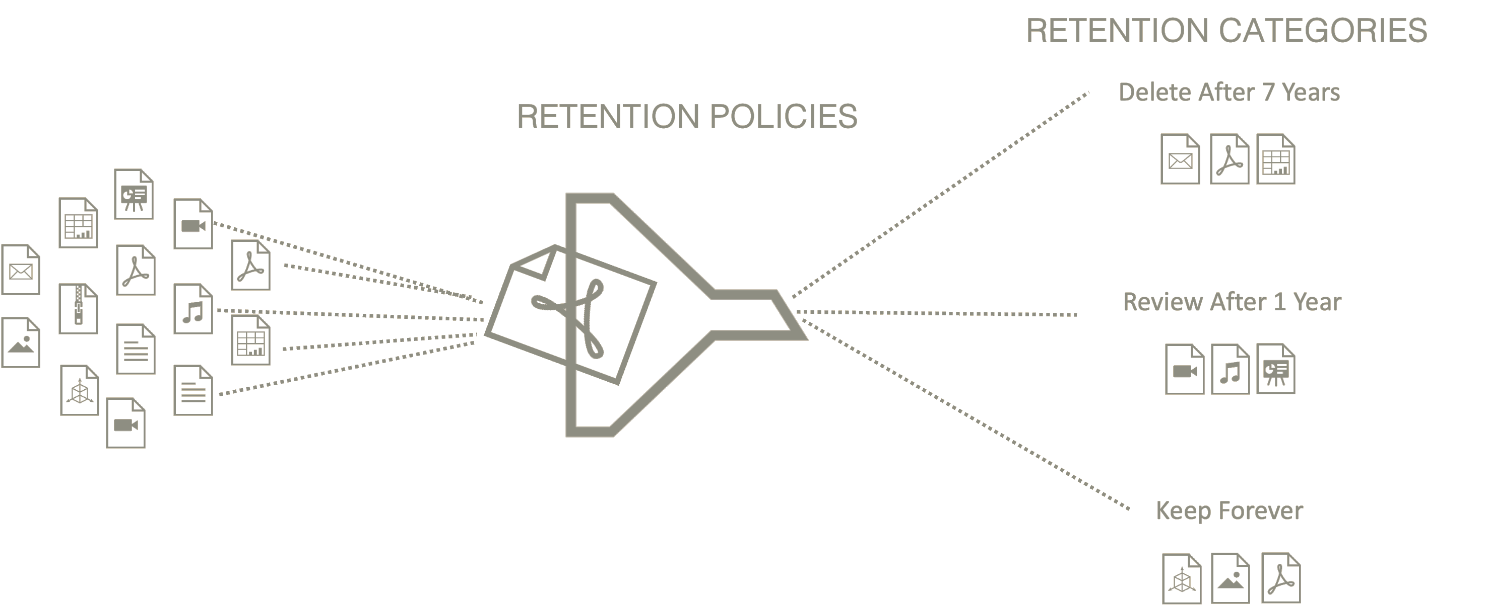




What is Modern Records Management?
Invoice
Notes:
What does modern records management look like in M-Files?
Content is stored in M-Files or connected vaults.
Retention policies automatically determine which content is included.
The policy automatically determines which category or retention to apply.
Content is automatically removed at the correct time.

Slide 3




Why M-Files Records Mgmt With AutoRecords
Ensure Compliance
Automate Processes
Configure & Extend
Business Ready
  Policy Enforced
  Disposition Logs
  Multi-Repository
  Policy Assignment
  Events & Actions
  Disposition Processing
  Customizable Workflow Actions
  Configurable Retention, Events & Triggers
  Audit History
  Hold Processing
  BI Reporting

Slide 4






How does AutoRecords work?
Manually
Manually
Text Analyzer
Class
Scanning
Automated Ingestion
Matcher
Classifier
Discovery
Metadata
Metadata
Time
Revision
Action Logging
Disposition Logging
Conflicts & Holds
AutoRecords
Docs Created
or Updated
Metadata
Assigned
Automated Policy
& Retention Category Assignment
Events Scheduled
Actions Executed

Slide 5
Demo
AutoRecords

Slide 6

Questions

